Slide 1
Chinese Language in the ACT region
Dr Mandy Scott
Saturday 10 August
Australian National University

Slide 2
Languages spoken at home in the ACT 2011
 | 2011 |  |  | 2006 |  |  | Change 2006 to 2011
 | Number | % | Australia | Number | % | Australia
English only | 278,025 | 77.8 | 76.8 | 261,851 | 81 | 78.5 | +16,174
Mandarin | 6,673 | 1.9 | 1.6 | 3,653 | 1.1 | 1.1 | +3,020
Vietnamese | 3,792 | 1.1 | 1.1 | 3,100 | 1.0 | 1.0 | +692
Cantonese | 3,468 | 1.0 | 1.2 | 2,879 | 0.9 | 1.2 | +589
Italian | 3,306 | 0.9 | 1.4 | 3,423 | 1.1 | 1.6 | -117
Spanish | 2,927 | 0.8 | 0.5 | 2,460 | 0.8 | 0.5 | +467
Greek | 2,773 | 0.8 | 1.2 | 2,558 | 0.8 | 1.3 | +215
Arabic | 2,411 | 0.7 | 1.3 | 1,378 | 0.4 | 1.2 | +1,033
Croatian | 2,399 | 0.7 | 0.3 | 2,498 | 0.8 | 0.3 | -99
Hindi | 2,315 | 0.6 | 0.5 | 1,377 | 0.4 | 0.4 | +938

Slide 3
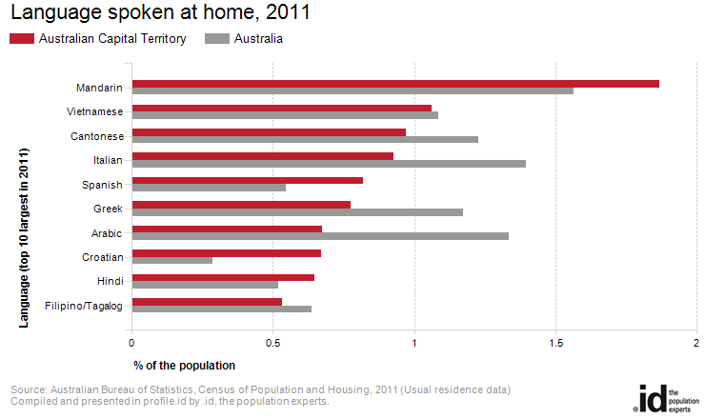

Slide 4
ACT | 2011 |  |  | 2006 |  |  | Change
Ancestry | Number | % | Australia | Number | % | Australia
Australian | 128,711 | 36.0 | 33.0 | 133,004 | 41.1 | 37.1 | -4,293
English | 116,676 | 32.7 | 33.7 | 100,715 | 31.2 | 31.6 | +15,961
Irish | 44,456 | 12.4 | 9.7 | 37,560 | 11.6 | 9.1 | +6,896
Scottish | 34,745 | 9.7 | 8.3 | 29,076 | 9.0 | 7.5 | +5,669
German | 15,514 | 4.3 | 4.2 | 14,199 | 4.4 | 4.1 | +1,315
Chinese | 14,942 | 4.2 | 4.0 | 10,046 | 3.1 | 3.4 | +4,896
Italian | 11,620 | 3.3 | 4.3 | 10,595 | 3.3 | 4.3 | +1,025
Indian | 8,051 | 2.3 | 1.8 | 4,353 | 1.3 | 1.2 | +3,698
Dutch | 6,417 | 1.8 | 1.6 | 5,891 | 1.8 | 1.6 | +526
Greek | 4,552 | 1.3 | 1.8 | 4,219 | 1.3 | 1.8 | +333

Slide 5
School-age students studying Mandarin in the ACT in 2013
Type and number of schools | Students
Community Language School (4) | 518
Government - primary level (3) | 715
Independent - primary level (1) | 189
Government High School (2) | 255
Government Colleges (6) | 188 (>86 Int)
Independent - secondary level (2) | 673
Catholic secondary level (1+) | 35
TOTAL | 2373

Slide 6
Student retention
Gov HS (2) | Year 7 | 8 | 9 | 10
 | 124 | 89 | 22 | 18
Independent | Year 8 | 9 | 10 | 11 | 12
 | 28 | 26 | 15 | 8 | 6

Slide 7
Students in ACT Colleges in Years 11 and 12

Slide 8
Parents’ Survey (47 responses)
Chinese Speaker? | Chinese speaking Partner | Community language school (CLS) | Mainstream schools (MS) | Childcare | Other
YES n=30 (CS) | 19 | 24 | 3 | 2
NO n=17 (NCS) | 2 | 5 | 5 | 7 | 3
Do you (CS parents) speak to your children in Mandarin? | Never | Occasionally | Often | Mostly | All the time
 | 0 | 6 (20%) | 11 (37%) | 8 (27%) | 5 (17%)

Slide 9
Strengths/good things about current opportunities for children in Canberra to learn Mandarin? (NCS parents)
Opportunities to learn/ be immersed in Mandarin from a young age
Chinese Language Schools (CLS) support native and non-native speakers and families. The fees are also affordable
Mandarin speaking community; children have friends from Chinese families from Chinese families
What could be improved?
More engaging teaching, more time each week and integrating M into the rest of the curriculum so that it appears more relevant for students,
Better transparency regarding measuring Mandarin proficiency.
More programs, and increased access: for young children (under 5); in the private school system; in secondary schools
More dedicated approach to support children to become fluent who are from non Mandarin speaking families

Slide 10
Comments from NCS parents
“I wish we had an alternative to the Saturday morning class, I can foresee a time when one of my children might have to stop due to involvement in a team sport or dance class”
“I wish our schools took 2nd languages more seriously and expected higher levels of competence from students. I also understand there are issues having language speakers teach if they do not have Australian teaching training. Please be more flexible. At a minimum they could be teachers' assistants, after school child minders etc”

Slide 11
Strengths/good things about current opportunities for children in Canberra to learn Mandarin? (CS parents)
Large/growing native-speaking community; strong support for Chinese learning, a lot of parents want to send children to learn Chinese
A number of low cost Chinese schools in different areas
Availability of immersion/bilingual programs; great opportunity for learning in a more intensive environment than 1-2 hours per week; free public bilingual primary school.
Chinese books at some libraries
Support from local government and Chinese Embassy
Compared to Sydney, there isn't much pressure/competition to excel academically, so we can find leisure time to learn Mandarin for pleasure (as opposed to all the free time spent coaching, doing HW).

Slide 12
What could be improved? (CSP)
CLS: More interesting and appropriate text books and teaching methods. Better discipline. Give students interesting things to read, encourage them to write using what they have learnt: sentences, paragraphs
Expand the one day a week intensive Mandarin program, make the program truly bilingual; open a bilingual primary school in the North, as it has a bigger Chinese population.
School and community libraries and bookstores should stock more children’s Chinese books and Mandarin DVDs.
Organise "play dates" to put Chinese speaking kids in contract with non-Chinese speaking kids currently learning Chinese to play together and naturally pick up Chinese
More interactive activities aimed at improving kids' Chinese (outside schools).

Slide 13
Comments from Chinese-Speaking parents
“Do not think Mandarin belongs to the Chinese. Just treat it as an important language and skill, then children will not be against learning it. This is also linked to respect for people from another culture. When parents respect the culture, children are willing to learn the languages and the culture”.
“If Chinese learning can be a fun experience for children, it will be great. Currently my son doesn't want to go to Chinese school. It's very hard for us to push it. If it can be as fun and enjoyable, I think it will help kids continue going to school to learn Chinese”.

Slide 14
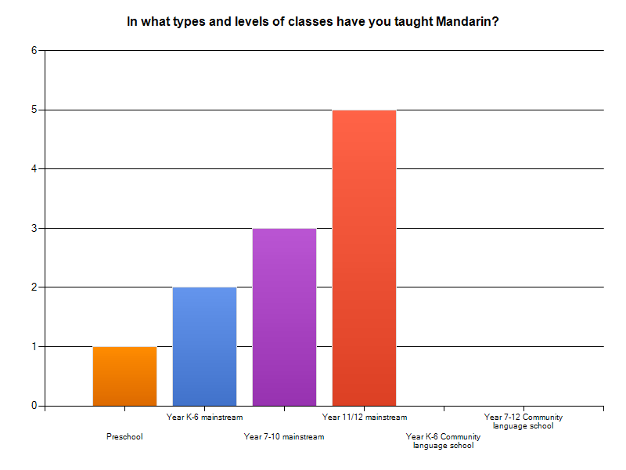
Teachers’ survey (7 responses) Five teachers had experience in the types of classes shown in the chart below, one did not identify where they taught (possibly CLS?) and one did private tutoring.

Slide 15
What are the main challenges?
TIME
In primary school very little time and resources given to the study of Mandarin (MS Pre-12)
Timetabling (MS K-12); time to work together for the activity to be materialized. (MS 7-12)
Not enough Chinese learning and practice between lessons (CLS?)
RESOURCES
Boring and old textbooks (CLS?)
INTEREST/ABILITY
In 7-8 classes mainstream students not all necessarily interested or capable to learn another language if they cannot master their first language (MS 7-12).
Students don't like writing (CLS?)
To get a sufficient number of students in Beginning Chinese (MS11/12).
ATTITUDES
Families are still racist, biased and bigoted. Teachers are still biased (PreSch-12).
The majority of parents expect the Chinese school to take all the responsibilities for their children's learning. (CLS?)
PRODUCTIVE SKILLS
Tones, writing characters (Private tutoring); Speaking and writing (MS 11/12)

Slide 16
What would help improve outcomes in terms of communicative abilities in Mandarin?
RESOURCES
Students need to be in an environment with native speakers and activities that use the spoken language (MS 7-12).
Access to native speakers and really life interactions (preSch-12)
A good textbook (CLS?); learning materials (Private tutoring); phrase, clause, sentence level need introducing (MS 11/12).
TIME
More time to spend on spoken Chinese classes (MS K-12)
Whole lesson time just for Beginning Chinese, not in a multi-level class: teaching beginning, continuing and advanced students in the same time (MS 11/12).
ATTITUDES
Increased awareness and support of Chinese learning in the Chinese Community. (CLS?)
Attitudes of the general public to the study of Mandarin (preSch-12)

Slide 17
Other issues/comments
If Mandarin is to be offered in any school, a whole school approach is needed to support the program (MS 7-12).
Teachers have to be passionate themselves in delivering the language (MS 7-12).
Best practice needed in Chinese teaching and learning targeting overseas born children (CLS?).
Expecting actual information and practical advice, not too much theoretical discussions and lectures (MS 11/12)

